Slide 1

Year 7 Science

Slide 2
Objectives
Get to know each other
Discuss expectations
Discuss assessment outline

Slide 3
My name is…
Mr Johnson

Slide 4

Why are we here?

Slide 5

What is Science?

Slide 6
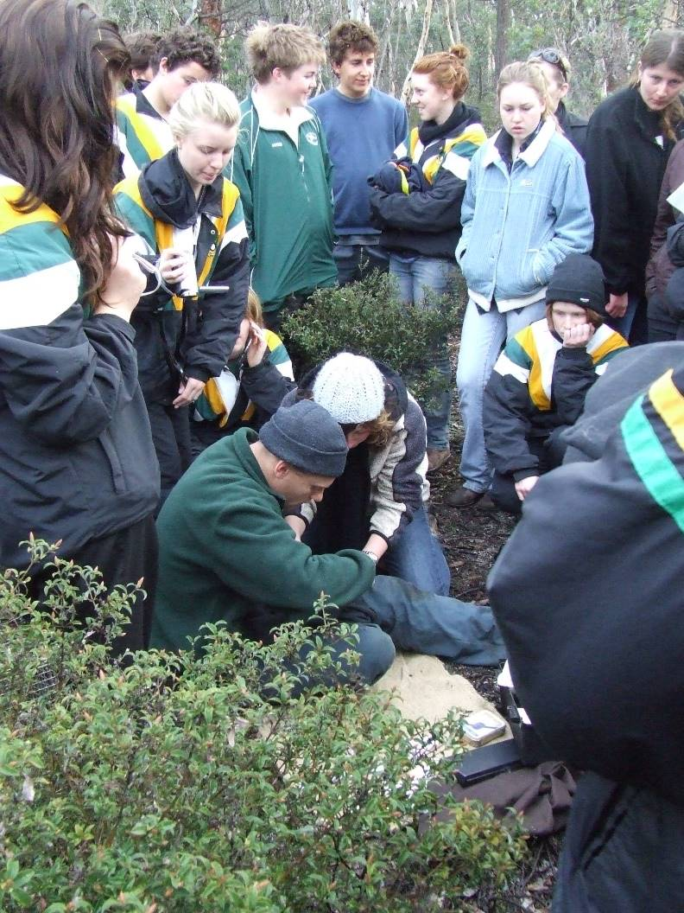
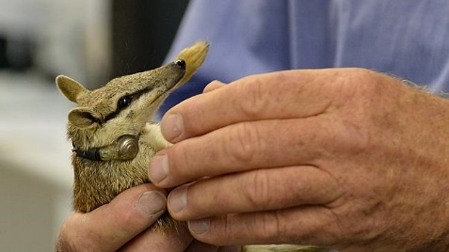
Programme and Assessment
Investigating Outline

Slide 7
Expectations
Respect
Responsibility
Tolerance

Slide 8
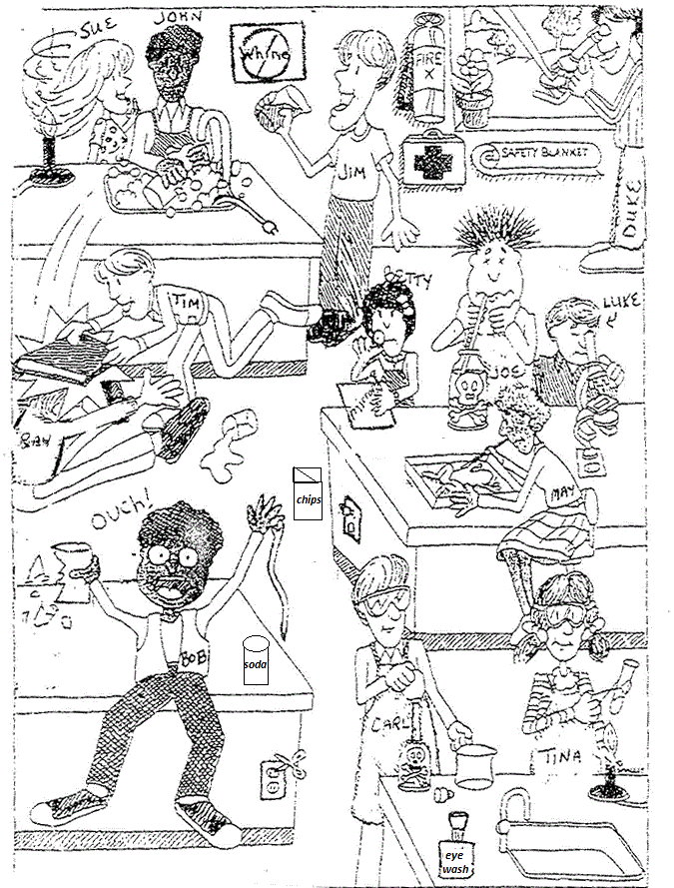
Staying Safe

Slide 9
Remember To Stay Safe
Only do what I tell you to do
Be aware of what is happening around you

Slide 10
What to bring to each lesson…
File and pencil case
Homework diary
Safety glasses
Your text book can stay in the class room. If you have a computer at home you can access your text book online.

Slide 11
Homework
Due Friday 10 February
Do a little bit each night!

Slide 12
Review
Got to know each other
Got to know expectations
Discussed assessment outline

Slide 13
Next time…
Which is Water Investigation?

